Slide 1

Predicting In-Hospital Patient Mortality Using Scikit-Learn and H2O.ai
By Manny Argueta

Slide 2
Introduction
Manny Argueta
UC Davis Alumni
M.S. Engineering Student @ UCR
Specializing in Data Science
Process Scientist at Boehringer Ingelheim
Former pre-med student, still trying to make an impact in healthcare

Slide 3
Introduction
ICU data has been made available for decades, and many competitions were aimed at utilizing the data to solve prevalent healthcare issues
Emergency health data has shown that when used to extract knowledge, it can have impact:
Hospitals shown to overuse blood cultures (Mccaig et al., 2006)
Helped identify exposure to disasters (Niska, 2007)
Project Purpose: To create a prediction model that can predict in-hospital outcomes for ICU patients

Slide 4
introduction
The model was implemented using python, scikit-learn and h2o
H2o’s framework works well with python and integrates well with scikit-learn
MIMIC-II dataset used for this study is 4000 instances

Slide 5

methodology
Approach
The general approach is shown in the figure to the right
The model will be accepted based on its performance compared to competitors in 2012 computing in cardiology competition
Data mining pipeline (Aggarwal, 2015)

Slide 6
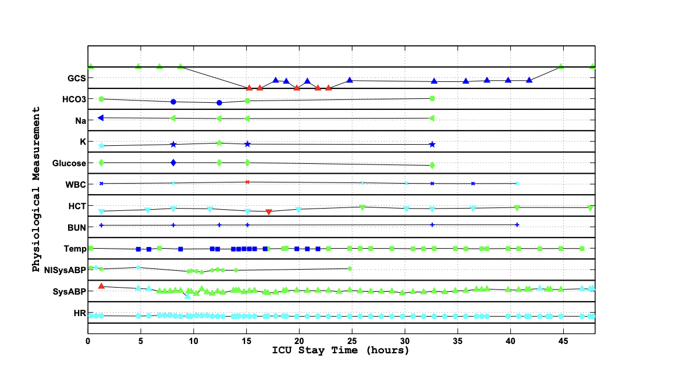
methodology
Data collection
Collection of data was performed at beth israel deaconess medical center
The MIMIC dataset collected time-series data for each patient over the course of 48 hours
Feature extraction was used to handle time-series data and have it work with static data points
A single patient from MIMIC II (Johnson et al., 2015)

Slide 7
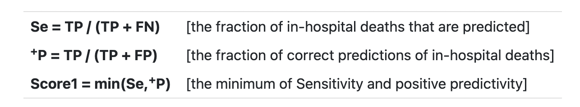
methodology
Analytic Methods
Use h2o ensemble method to prediction patient mortality:
Random forest
Gradient boost Machine
Deep learning
Model performance measured primarily by sensitivity and positive predictivity (minimum of the two)
Additional metrics include Auroc/aucpr
Sensitivity and Predictivity Equations
(Johnson et al., 2016)

Slide 8
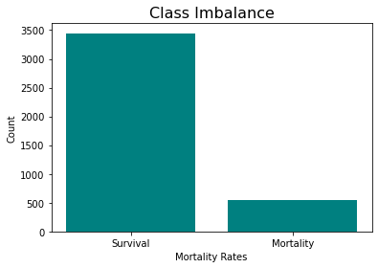
results
Significant class imbalance between survival and mortality rates
Class imbalance between positive and negative outcomes

Slide 9
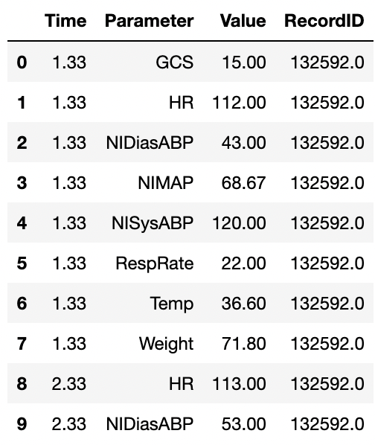
results
Time-stamps had no time of day, week, or year
Instead, time stamps function better and a measure of hours since patient admittance to icu
Sample patient values with time conversion

Slide 10
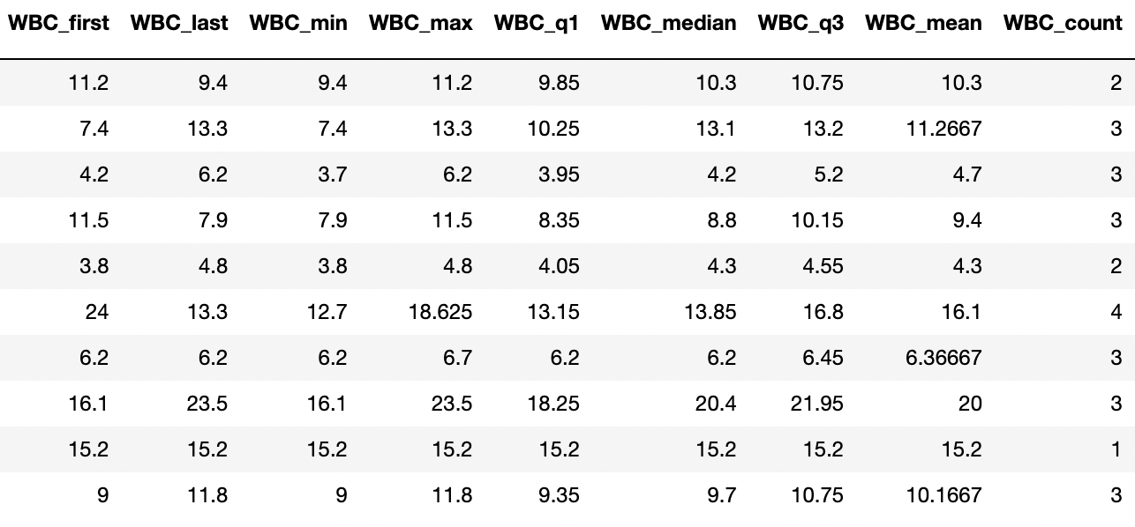
results
Minimum, maximum, first value, last value, mean, q1, median, q3, count
If parameters were missing for patient, mean values were input
White blood cell metrics after feature extraction

Slide 11
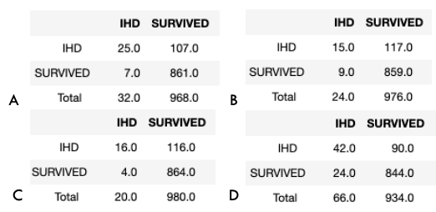
results
A) Random forest
B) Gradient boost
C) Deep learning
d) Stacked ensemble
Confusion matrices

Slide 12
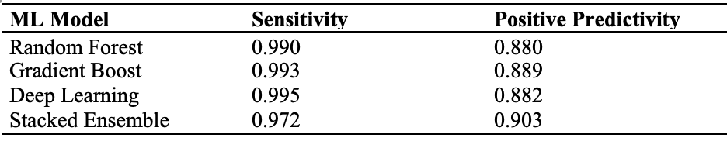
results
Sensitivity and positive predictivity

Slide 13
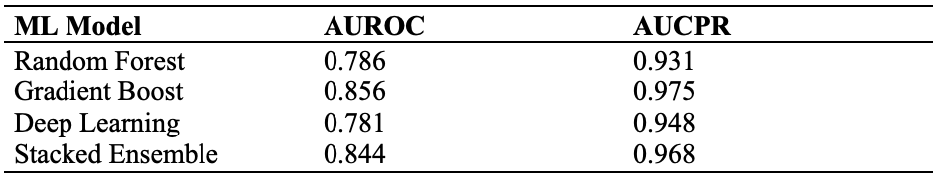
results
AUROC and AUCPR

Slide 14
discussion
Feature extraction transformed the data and had a significant number of missing values
Model has high sensitivity and high positive predictivity
High aucpr as well may mean that the model is overfitting to the data
It is also likely affected by the class imbalance
However, lower auroc in combination with above indicates some robustness
Can use the remaining part of the mimic dataset to adjust parameters and reduce overfit

Slide 15
Conclusion
The model successfully classified a majority of the dataset
Future directions include increasing generalization of the model
H2o and scikit-learn were able to create a viable classification model
Machine learning models like this can help healthcare professionals improve their care

Slide 16
References:
Johnson, A. E. W., Pollard, T. J., Shen, L., Lehman, L. H., Feng, M., Ghassemi, M., Moody, B., Szolovits, P., Anthony Celi, L., & Mark, R. G. (2016). MIMIC-III, a freely accessible critical care database. Scientific Data, 1. https://doi.org/10.1038/sdata.2016.35
Johnson, A., Pollard, T., & Mark, R. (2019). MIMIC-III Clinical Database Demo (version
1.4). PhysioNet. https://doi.org/10.13026/C2HM2Q.
McCaig, L. F., McDonald, L. C., Cohen, A. L., & Kuehnert, M. J. (2007). Increasing Blood Culture Use at US Hospital Emergency Department Visits, 2001 to 2004. Annals of Emergency Medicine, 1, 42-48.e2. https://doi.org/10.1016/j.annemergmed.2006.12.002
Goto, T., Camargo, C. A., Faridi, M. K., Freishtat, R. J., & Hasegawa, K. (2019). Machine Learning–Based Prediction of Clinical Outcomes for Children During Emergency Department Triage. JAMA Network Open, 1, e186937. https://doi.org/10.1001/jamanetworkopen.2018.6937

Slide 17
References:
Niska, R. W. (2008). Hospital Collaboration with Public Safety Organizations on Bioterrorism Response. Prehospital Emergency Care, 1, 12–17. https://doi.org/10.1080/10903120701709514
Rong, G., Mendez, A., Bou Assi, E., Zhao, B., & Sawan, M. (2020). Artificial Intelligence in Healthcare: Review and Prediction Case Studies. Engineering, 3, 291–301. https://doi.org/10.1016/j.eng.2019.08.015
Aggarwal, C. C. (2015). Data Mining. Springer.
Dulhare, U. N., Mubeen, A., & Ahmad, K. (2020). Hands‐On H2O Machine Learning Tool. Machine Learning and Big Data, 423–453. https://doi.org/10.1002/9781119654834.ch15
El-Rashidy, N., El-Sappagh, S., Abuhmed, T., Abdelrazek, S., & El-Bakry, H. M. (2020). Intensive Care Unit Mortality Prediction: An Improved Patient-Specific Stacking Ensemble Model. IEEE Access, 133541–133564. https://doi.org/10.1109/access.2020.3010556

Slide 18
References:
Friedman, J. H. (2001). Greedy function approximation: A gradient boosting machine. The Annals of Statistics, 5. https://doi.org/10.1214/aos/1013203451
Géron, A. (2017). Hands-On Machine Learning with Scikit-Learn and TensorFlow. O’Reilly Media.
Johnson, A., Dunkley, N., Mayaud, L., Kramer, A., & Clifford, G. (2012). Patient Specific Predictions in the Intensive Care Unit Using a Bayesian Ensemble. Computing in Cardiology.
Kuo, B.-C., & Landgrebe, D. A. (2004). Nonparametric weighted feature extraction for classification. IEEE Transactions on Geoscience and Remote Sensing, 5, 1096–1105. https://doi.org/10.1109/tgrs.2004.825578
Sharma, A., & Rani, R. (2017). An Optimized Framework for Cancer Classification Using Deep Learning and Genetic Algorithm. Journal of Medical Imaging and Health Informatics, 8, 1851–1856. https://doi.org/10.1166/jmihi.2017.2266

Slide 19
Submission code
0daf2a80-1cf1-4f48-8b94-357e770dc493

